Slide 1
Ahihi
Discovery Social Network App
Class: SE357.M12.PMCL
Instructor: Nguyen Trinh Dong
Student: Nguyen Van Dat (19521347)

Slide 2

Business Requirement
01
Application Overview
02
Logical View
03
Deployment View

Slide 3
Application Overview

Slide 4
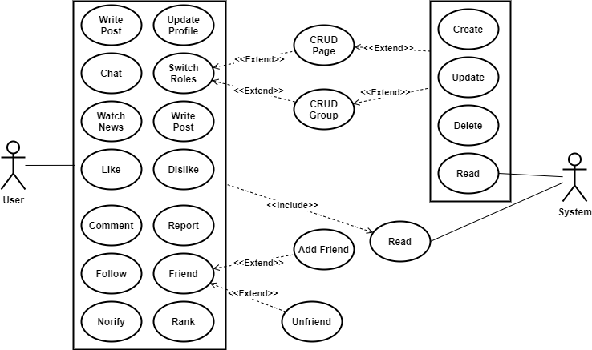
Use Cases (User role)

Slide 5
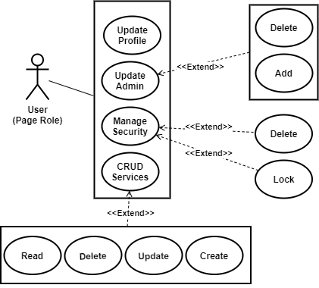
Use Cases (Page role)

Slide 6
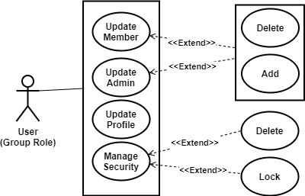
Use Cases (Group role)

Slide 7
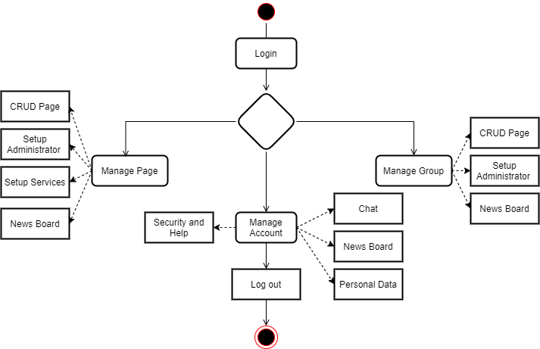
Application Overview

Slide 8
Function List
Login | Login
 | Login by APIs
Manage Account | Forgot Password
 | Register
 | Change Password
 | Add Friend
 | Delete Friend
 | View Friend List
 | Lock Account
 | Change Account Information
 | Help
 | Create Page
 | Create Group
 | Switch Page/Group
News Feeds | Write Post
 | Write comment
 | Like
 | Disklike
 | Report
 | Search
 | Watch News
 | Block News
Services | Book Services
 | Edit Services
 | Add Services
Manage Page | Lock Page
 | Open Page
 | Delete Page
 | Edit Page
 | Ranking
 | Register ADS
 | View ADS
 | Cancel ADS
 | Add Admin
 | Delete Admin
 | Get Admin List
Manage Group | Lock Group
 | Open Group
 | Delete Group
 | Edit Group
 | Add Member
 | View Member
 | Delete Member
 | Add Admin
 | Delete Admin
 | Get Admin List
Notification | View Notification List
Chat | View Chat list
 | View Friend List

Slide 9




Application Overview
Problem | Solve
Media | Store on CDN
Notification, chat,… real time | WebSocket and Socket handler
Security | OAuth2
Payment | Use Agent’s APIs

Slide 10
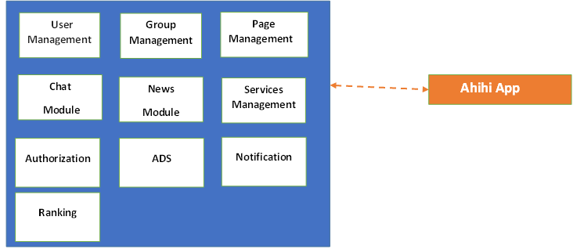
Domain Diagram

Slide 11
Workflow

Slide 12
Logical View

Slide 13
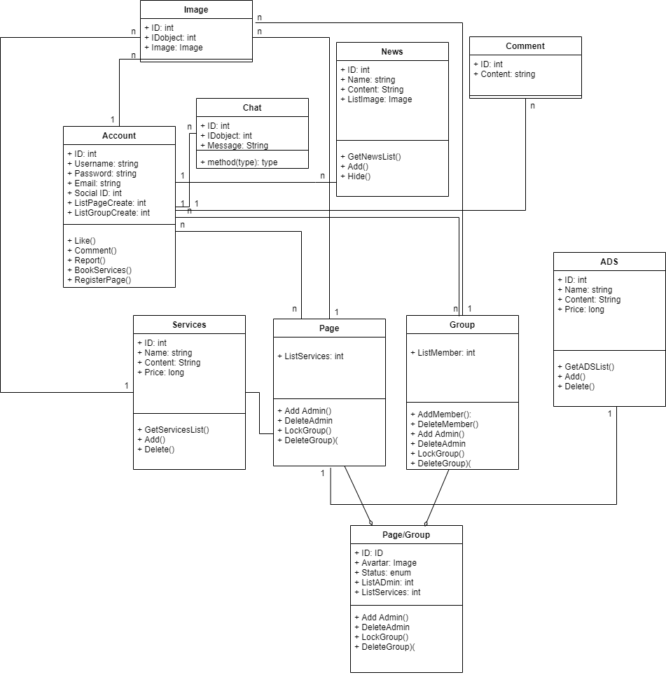
Class

Slide 14
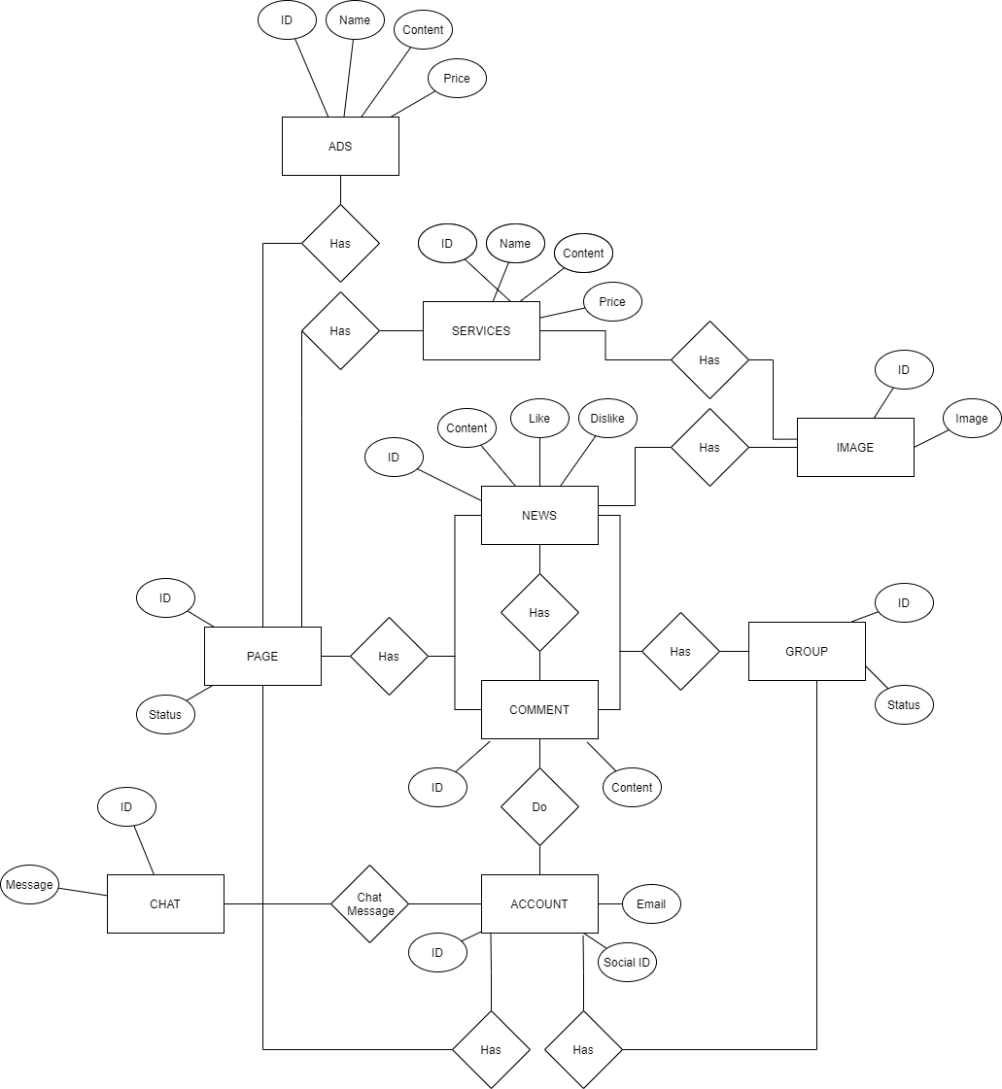
ER

Slide 15
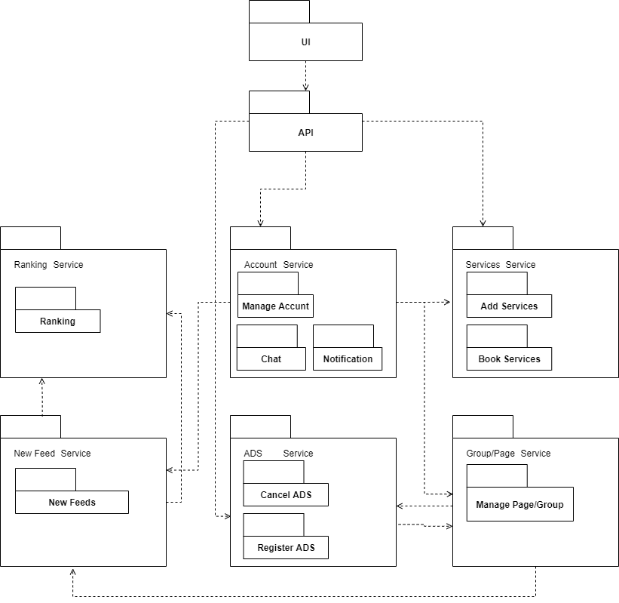
Module Diagram

Slide 16
Deployment View

Slide 17
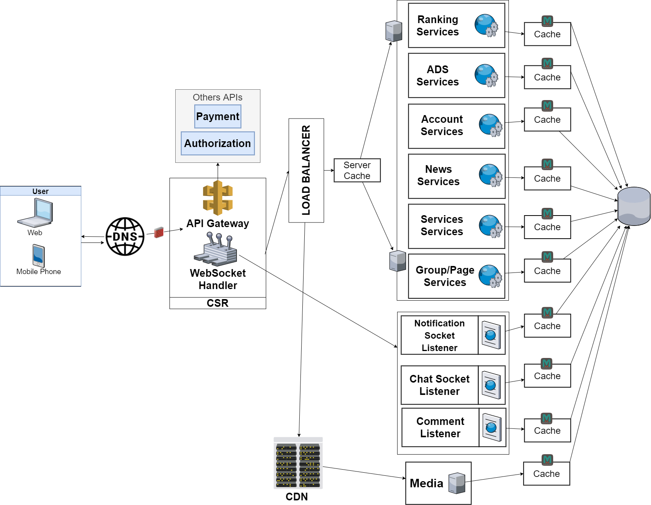
Architechutre

Slide 18
Thank you
FOR LISTENING

